Slide 1
Welcome to Genomics and Bioinformatics week
Dr. Mike Tristem
Silwood Park
m.tristem@imperial.ac.uk

Slide 2
Structure of the week
Monday
9.15am-11am Lectures 1 and 2. Origins of genomes, genome organisation and new gene formation.
Tuesday
9.15am-11am Lectures 3 and 4. Mutation, SNPs, change in gene sequences over time. Introduction to bioinformatics.
2pm-5pm Practical 1 Introduction/refresher on basic bioinformatics tools. General sequence manipulation, BLASTING, alignments, and tree building.
Thursday
9.15am-11am Lectures 5 and 6. Genome evolution and selfish genetic elements.
2pm-5pm Practical 2. Genome databases and annotation, comparative genomics, SNPs.
Friday
9.15am-11am Lectures 7 and 8. Genes and populations. Population structure measurement and impact.
2pm-5pm Practical 3. Analysing sequence evolution and population structure, Jukes Cantor/Kimura, dN/dS ratios, Fst analysis, HWE.

Slide 3
Learning outcomes
By the end of the week you should be able to:
• Understand how genes arise and the mechanisms by which they do so
• Understand how genes and genomes evolve over time and the processes by which they do so
• Know the mechanisms behind genetic change within and between populations and species and how they are measured
• Be able to use bioinformatic tools to (i) manipulate gene and protein sequences, (ii) construct alignments, (iii) understand genome annotation and genome databases, (iv) be able to use online tools for a variety of evolutionary applications related to populations, species and genomes

Slide 4
Origin of new genes
By the end of lectures 1 and 2 you should be able to understand and explain
• the major sources of new gene formation
• redundancy
• the mechanisms of unequal crossover, gene conversion and concerted evolution
• the mechanism of pseudogene formation

Slide 5
Two Lecture Overview
Origin of new genes via:
• Formation of life (from a genetics perspective)
• Gene duplication
• De-novo
• Transposition
• Domain shuffling
• Lateral gene transfer

Slide 6
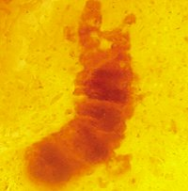
The origin of life (where did the first proteins come from?)
• cellular organisms first identified over
3.5 billion years ago
• cellular life preceded by pre-celluar systems systems
• microfossil 3.5 Ga
(Marble Arch, Australia)

Slide 7
The Stanley Miller experiment
• proposed constituents of early Earth
atmosphere:
water (H2O
methane (CH4)
ammonia (NH3) and
hydrogen (H2)
but no oxygen
• boil and subject to electrical discharge

Slide 8
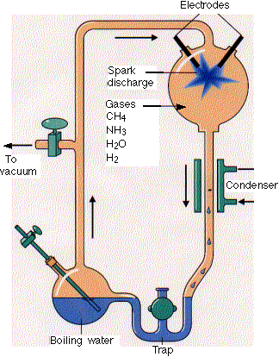
Resulted in:
• 17 of the 20 amino acids
used in protein synthesis
• all the purines and
pyrimidines used in nucleic
acid synthesis

Slide 9
An RNA Beginning?
• purely geochemical processes can lead
to synthesis of polymeric biomolecules
• paradox:
proteins cannot be made
without nucleic acids
nucleic acids cannot be
made without proteins

Slide 10
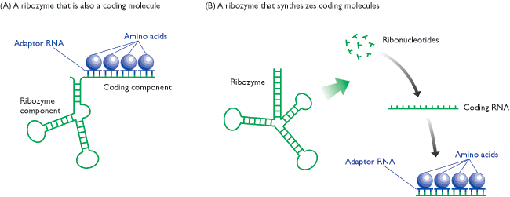
Evolution of the first coding RNA
(inc. first proteins)
• ribozyme could have evolved to have a dual
catalytic and coding function
• ribozyme could have synthesized a coding
molecule

Slide 11
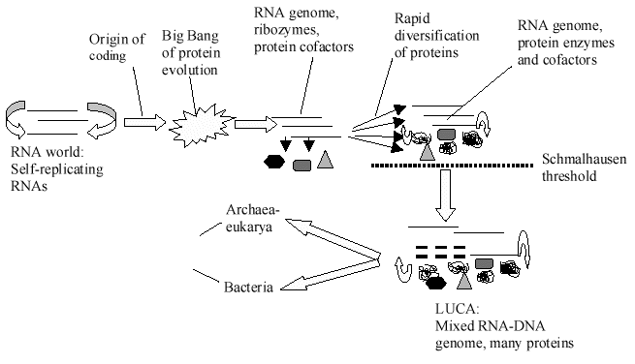
• LUCA=last universal common ancestor. Probably had a DNA genome and a few hundred genes

Slide 12
‘Universal genes’ (summary)
• only around 100 genes are universally present in all organisms (not enough for ‘life’-that needs around 300 genes?).
• these genes are functionally skewed (TCA cycle, transcription and translation machinery)
• thus many, original ‘LUCA’ genes must have
been lost from many organisms-to be replaced by other (non-homologous) genes with similar functions?
• there is therefore constant turnover of genes and evolution of new genes in ‘bursts’ (e.g via genome duplication) or more slowly with others being lost (see later in lectures e.g Syncytin)

Slide 13
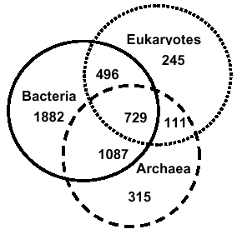
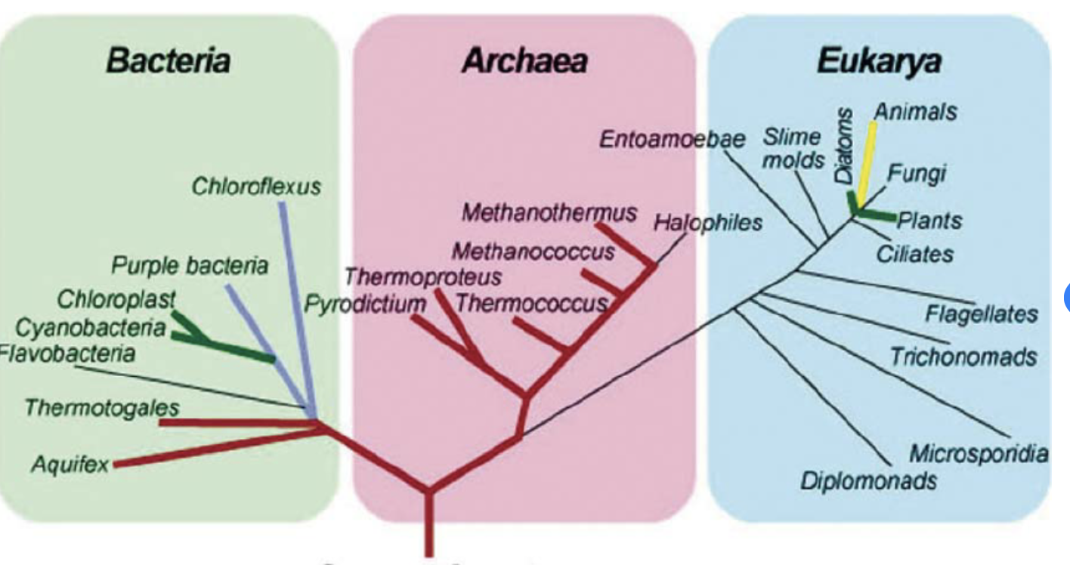
‘COGs’ in three domains of life
• a subset of these COGs probably
represents the minimum LUCA genome
• if Archaea and Eukarya are monophyletic then how is it that 1087 COGs are shared between Bacteria and Archaea, whereas only 111 are shared between Archaea and Eukaryotes? Are COGs=genes mobile?
Notes:
https://www.ncbi.nlm.nih.gov/research/cog
how these bacteria related to each other;
the types of genes they share, bacteria and archaea are more close – the gene transfer

Slide 14
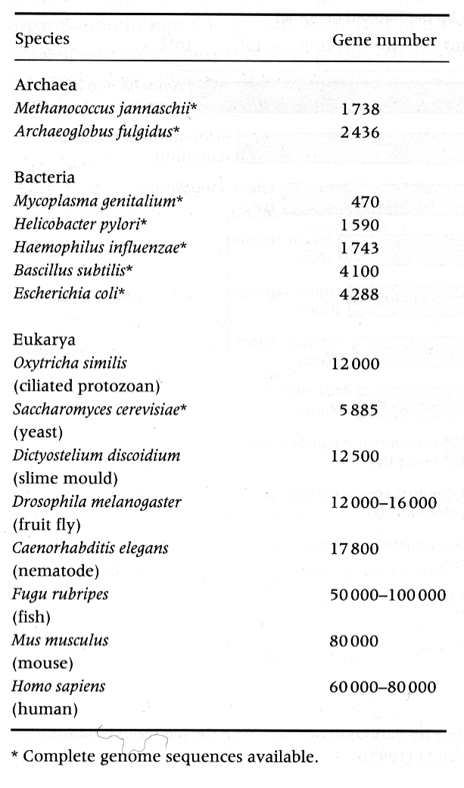
Gene numbers
• What is wrong with the
table?
• It is a table published around 20 years ago-before the huma genome had been sequenced….

Slide 15
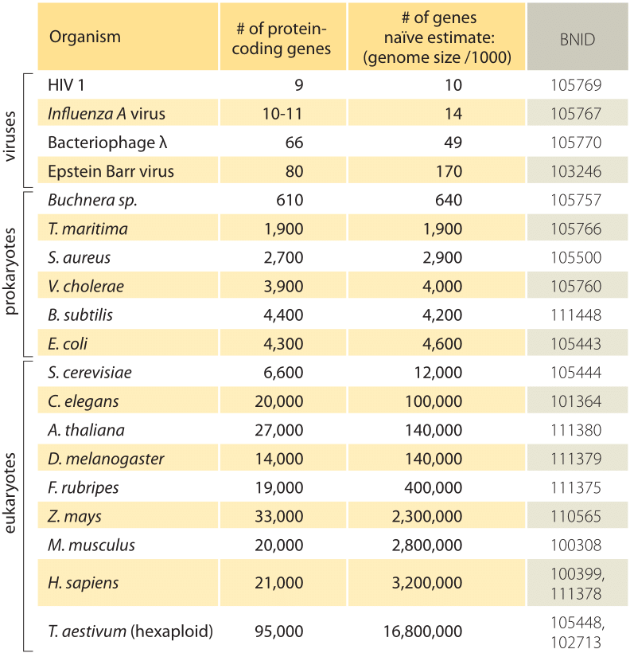
Modern estimates of protein coding gene numbers (about 2 years ago)
Latest estimates in humans:
Genes 21300 (still changing!)
Pseudogenes 15,000 (more later)
Hexaploid-more in a later lecture
http://book.bionumbers.org/how-many-genes-are-in-a-genome/
Notes:
https://www.biorxiv.org/content/early/2018/05/29/332825
https://www.ncbi.nlm.nih.gov/pmc/articles/PMC5691383/ (wheat has a haploid genome size of 15 billion bp-it is a hexaploid though so lots of almost identical sequences are present and presumably many of the gene sequences are redundant)

Slide 16
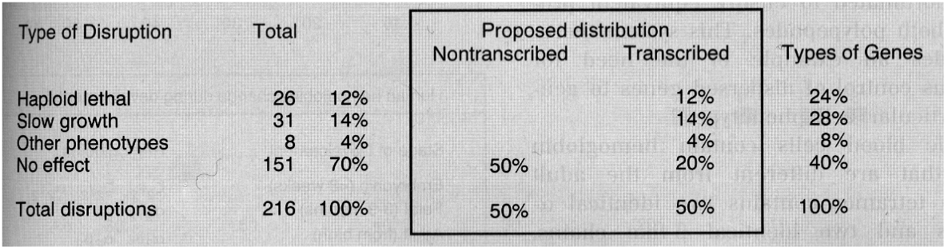
Essential and non-essential genes
• not all genes are essential
• disruption analysis using yeast suggests that
40% of genes have no phenotype
Notes:
Genes can be redone

Slide 17
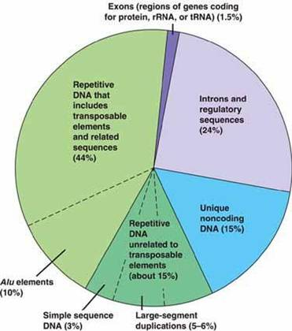
Genomic organisation of a typical eukaryotic genome
Selfish genetic elements and repetitive DNA will be covered in a later lecture

Slide 18
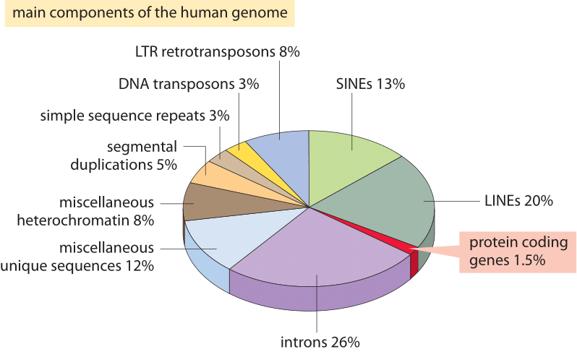
Another view with more details on selfish genetic elements

Slide 19
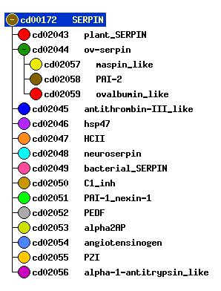
Genes and gene families-Introduction
• a good example of a gene family are the SERPINs
(serine protease inhibitors)
• most are suicide inhibitors-e.g. antithrombin
• they have lots of different functions though....
• ovalbumin=egg white storage protein + provides some immunity to micro-organisms?
Notes:
https://www.ncbi.nlm.nih.gov/Structure/cdd/cddsrv.cgi?uid=cd00172
Similarity test == blond test → to find what the relatives of the genes

Slide 20
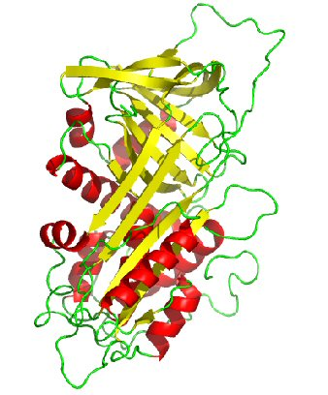
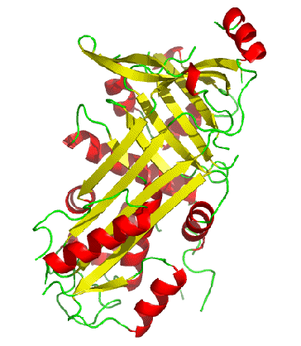
Anti-thrombin
Ovalbumin
• despite the different functions they have similar structures or ‘folds’

Slide 21
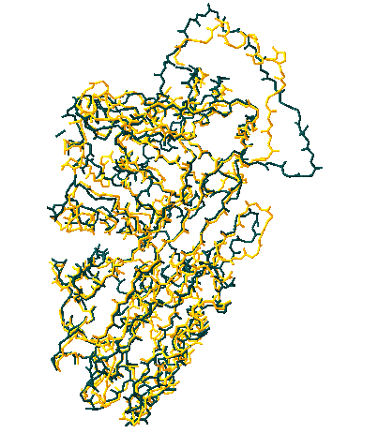
Both structures (superimposed)

Slide 22
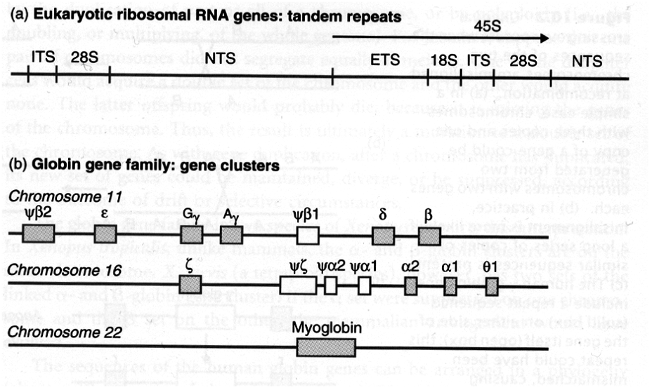
Evolution of multigene families
• multigene families can be tandemly repeated
or dispersed in gene clusters

Slide 23
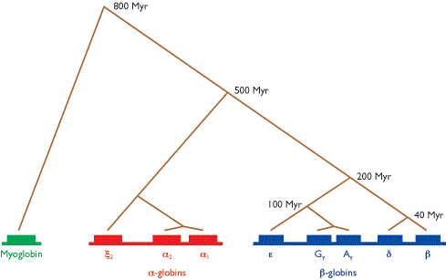
Globins arose from a single origin
(like all gene families)
• globin phylogeny

Slide 24
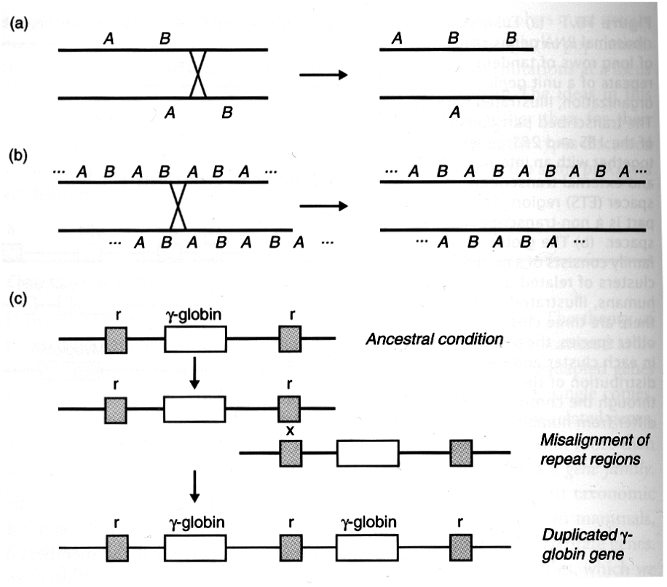
Evolved via unequal cross over events
• occurs when chromosomes are misaligned at
recombination (via mismatches at repeat
sequences)

Slide 25
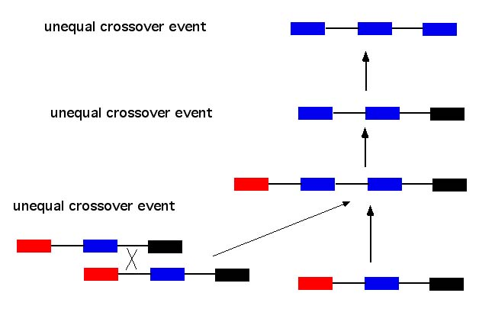
Formed via unequal crossover between similar sequences

Slide 26
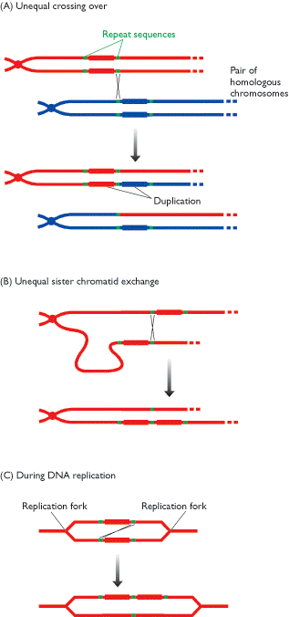
• unequal crossover in:
A) a pair of homologous
chromosomes
B) a pair of chromatids from
a single chromosome
C) in a replication bubble
In each case crossover occurs due to mis-alignment due to repeat sequences

Slide 27
• gene duplication and fixation
Notes:
• a duplicated gene can either first fix a null mutation (becoming a pseudogene) or can fix an advantageous mutation (which can lead to further divergence)

Slide 28
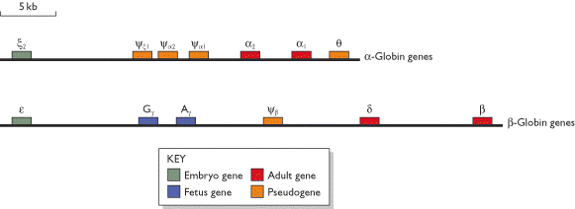
• the multi-gene globin family allows the
production different types of haemoglobin:
embryonic, foetal and adult
• they have different affinities for oxygen

Slide 29
• single mutations can lead to large differences
in gene function
Notes:
• often single mutations can lead to large differences in gene function eg emergence of regulation of haemoglobin by diphosphoglycerate.
• DPG binds to deoxygenated heamaglobin and upregulates release of remaining oxygen.

Slide 30
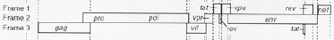
The split function model of gene
duplication
• vpr is a gene present within the primate
lentiviruses
• in HIV-2 vpr has duplicated and the virus
has both a vpr gene and a related vpx gene

Slide 31
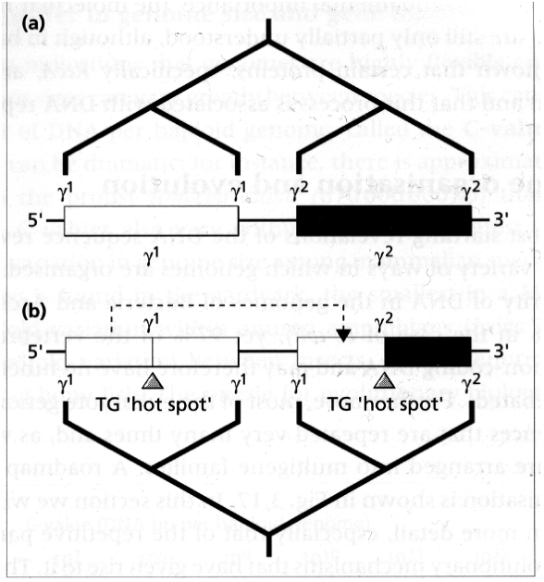
Gene conversion
• in gene conversion the DNA sequence of one
gene is replaced by the DNA sequence from another
• large scale gene conversion overed in a later lecture

Slide 32
rDNA gene evolution
• tandemly repeated gene families: evolve
by concerted evolution

Slide 33
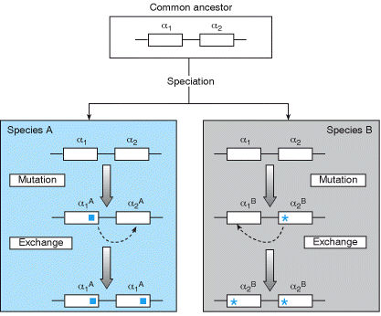
• signature is that paralogs are more
closely related than orthologs

Slide 34
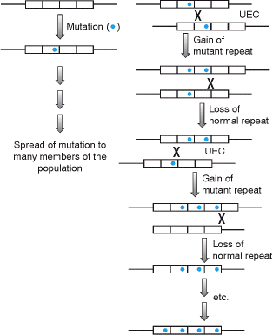
• concerted evolution
occurs via a
combination
of unequal cross-
over and gene
conversion

Slide 35
Other mechanisms of new gene formation
Gene duplication leads to about 40% of new genes being formed
Where do the others come from?

Slide 36
De novo formation

Slide 37
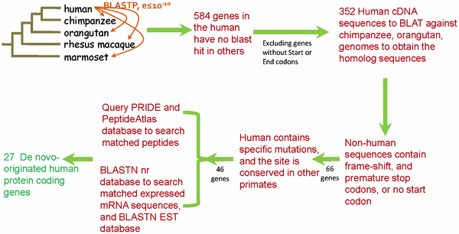
• numerous de novo genes have originated since the divergence of humans and chimpanzees
gene duplication and fixation
Notes:
BLASTP searches of human protein sequences against proteins of other primates identified 548 human genes without protein orthologs. After excluding these genes having no start or stop codons, 352 human coding sequences were used in BLAT searches to find orthologous genes in chimpanzee and orangutan and these sequences were examined to confirm the presence of disrupting mutations. 66 genes with disrupted open reading frames in chimpanzee and orangutan were examined to identify those with human-specific mutations that generate intact open reading frames, resulting 46 candidates. These genes were used as queries of mRNA and proteomic databases to confirm transcription and translation. The pipeline yielded 27 de novo originated protein-coding genes.

Slide 38
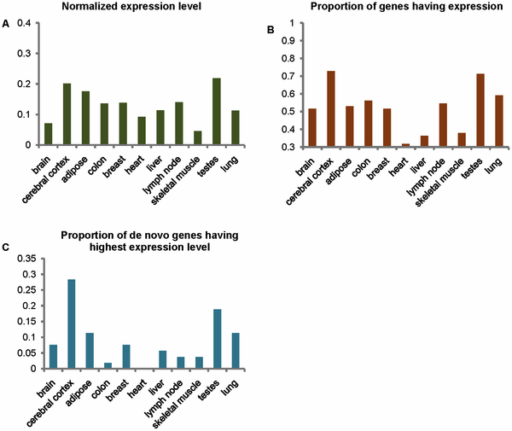
Expression is highest in testes and cerebral cortex

Slide 39
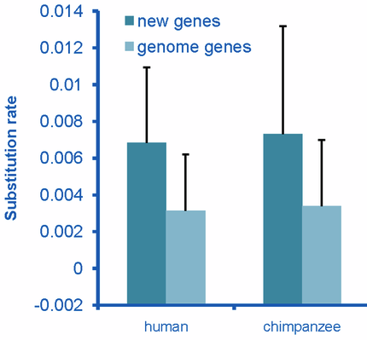
• De novo genes are evolving faster than other genes
• Human genes evolving more slowly than non-coding counterparts in chimpanzees
Notes:
Substitution rates for these sequences were calculated for both the human and chimpanzee lineages and these rates were compared to the genome-wide average rate for genes. The substitution rate for de novo genes was found to be higher than the genome-wide average rate on both the human and chimpanzee lineages (Figure 3), with the chimpanzee sequences evolving at the highest rate. The chimpanzee sequences were expected to evolve at a high rate, as these sequences should act as non-coding sequences rather than genes. The human sequences also evolved at an elevated rate, but at a rate that was slightly lower than that seen on the chimpanzee lineage.

Slide 40
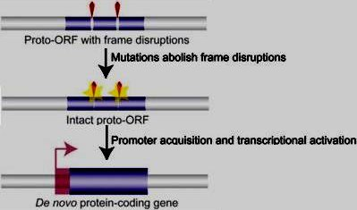
• Mechanism for de novo gene formation

Slide 41
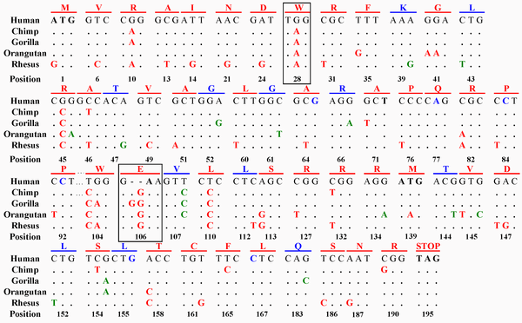
• de novo formation of new genes
the ‘motherless’ gene FLJ33706
• Note: only polymorphic sites shown

Slide 42
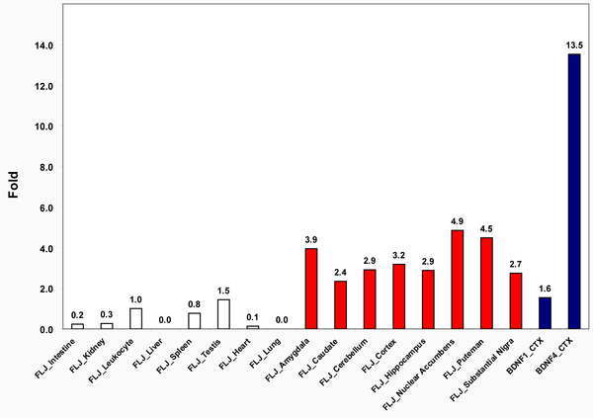
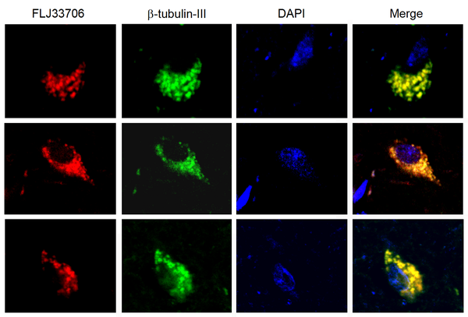
Human specific, it may be involved in nicotine addiction and Alzheimer’s disease
Neuron staining
Expression profiles. CTX=cortex

Slide 43
Formation via transposition

Slide 44
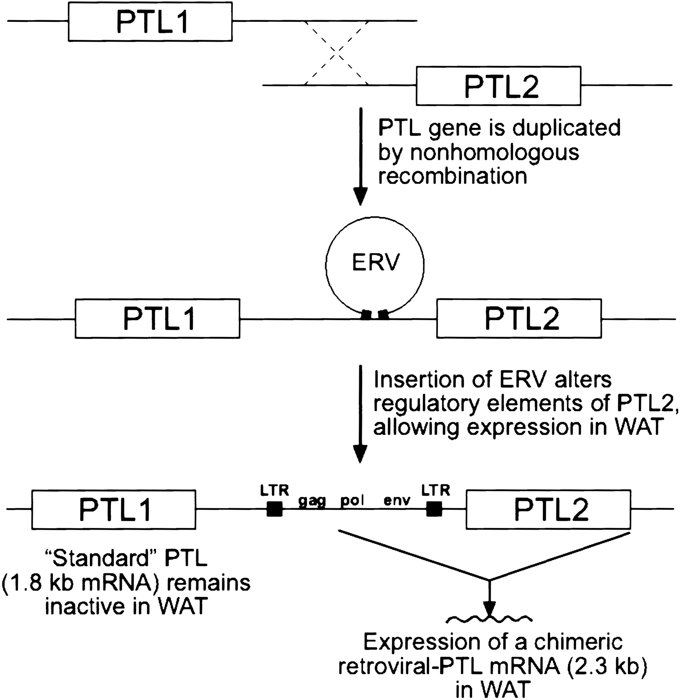
• LTR insertion in the pancreatic triacylglycerol gene in ground squirrels
• Expressed in white adipose tissue (see notes pages)
Notes:
‘Hibernating mammals can survive several months without feeding by limiting their carbohydrate catabolism and using triacylglycerols stored in white adipose tissue (WAT) as their primary source of fuel. Here we show that a lipolytic enzyme normally found in the gut, pancreatic triacylglycerol lipase (PTL), is expressed in WAT of hibernating 13-lined ground squirrels (Spermophilus tridecemlineatus). PTL expressed in WAT is encoded by an unusual chimeric retroviral-PTL mRNA ∼500 bases longer than the predominant PTL message found in other ground squirrel tissues. Seasonal measurements detect the chimeric mRNA and PTL enzymatic activity in WAT before and during hibernation, with both showing their lowest observed levels 1 wk after hibernation concludes in mid-March. PTL is expressed in addition to hormone-sensitive lipase, the enzyme typically responsible for hydrolysis of triacylglycerols in WAT. (https://pubmed.ncbi.nlm.nih.gov/11557627/)

Slide 45
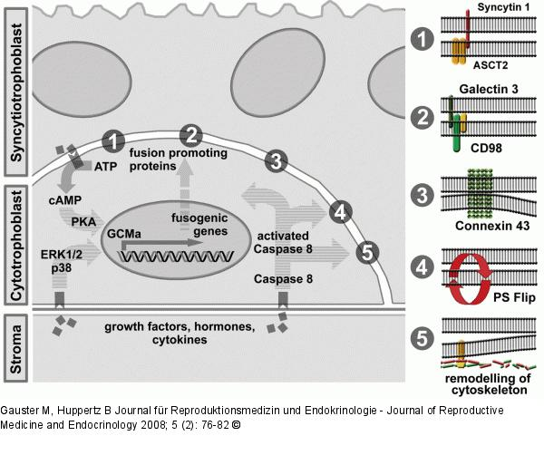
Retroposition followed by co-option is quite common
• syncytin
• hur1
• syncytin, part of
a retrovirus
but which part?
• ASCT2 is an
amino acid
transporter
Notes:
Here is a paper by one of my friends and colleagues: https://royalsocietypublishing.org/doi/pdf/10.1098/rstb.2012.0507

Slide 46
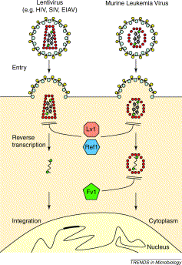
• The Fv1 gene in mice encodes a restriction factor which blocks infection by some retroviruses
• Other (non retroviral proteins have also evolved with similar functions in the same and different species=high turnover again?)
Notes:
And one by another friend and colleague: https://www.pnas.org/content/115/40/10130

Slide 47
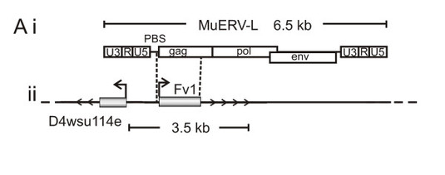
• It is derived from part of the gag gene from another retrovirus

Slide 48
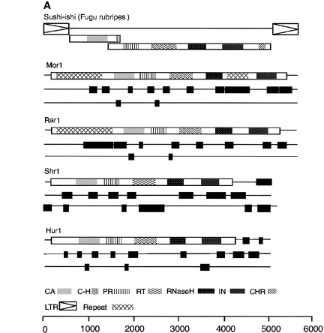
• Hur1 is a co-opted LTR-retrotransposon
with a 4KB ORF
• This is one I discovered-all plancental mammals have the gene which has a huge ORF
Notes:
And at the risk of hubris one by me: https://www.sciencedirect.com/science/article/pii/S0960982203006183
It turns out my speculation was wrong-the protein is involved in capillary support in the developing embryo-try predicting that from bioinformatics! It is conserved in all placental mammals. https://www.ncbi.nlm.nih.gov/gene?Db=gene&Cmd=DetailsSearch&Term=388015

Slide 49
Formation via domain shuffling

Slide 50
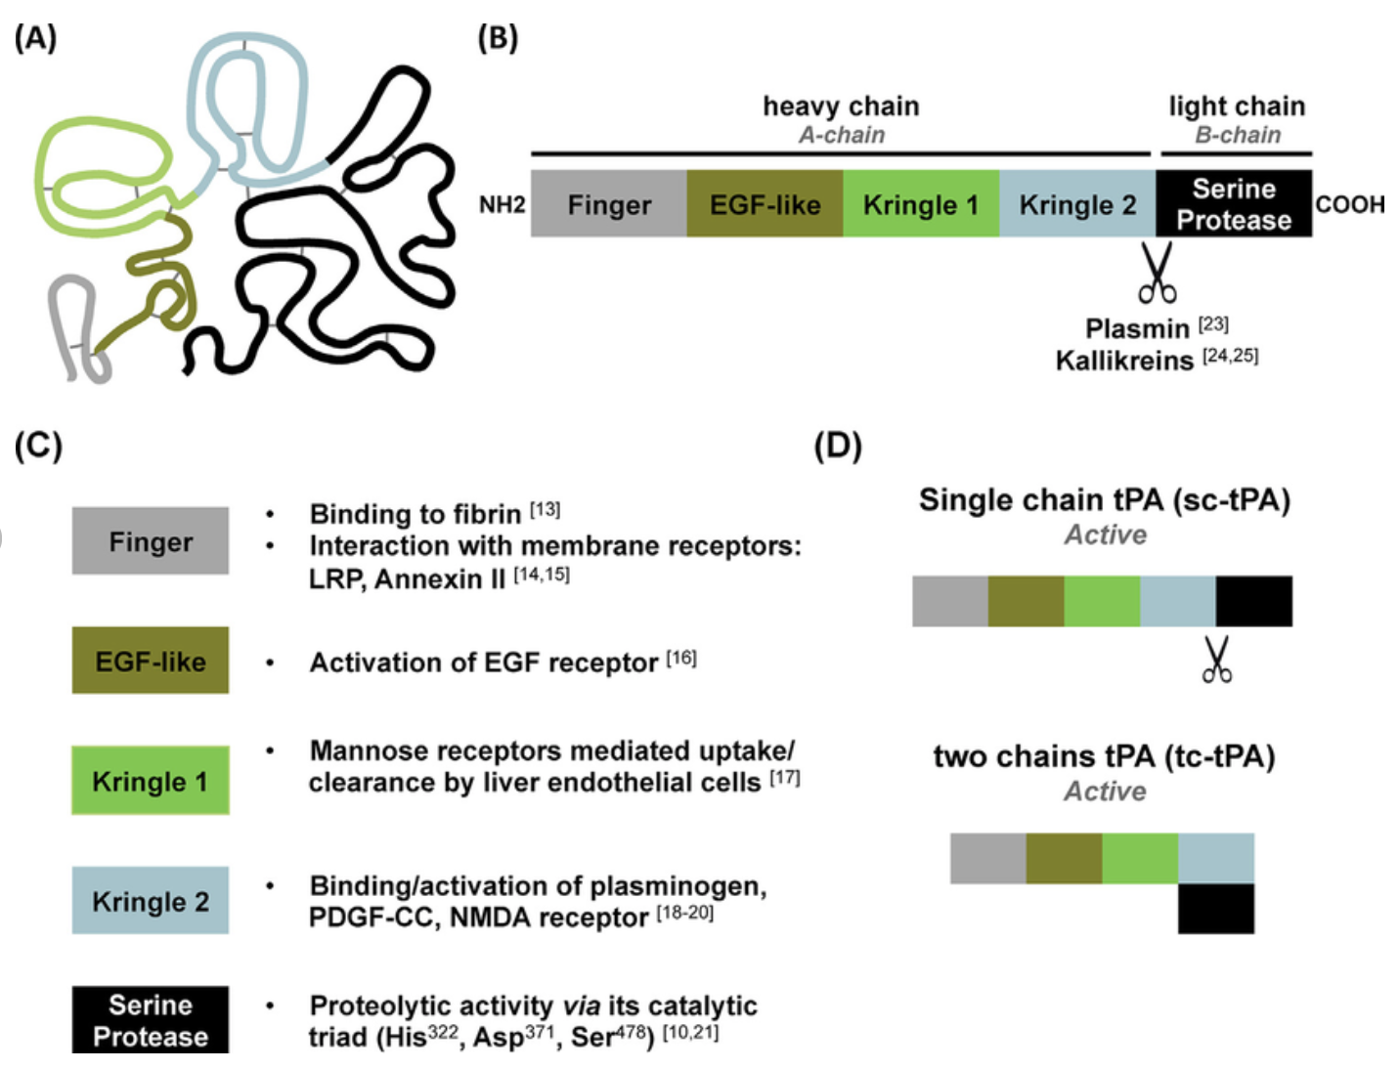
• exon shuffling and the origin of new genes
• Tissue plasminogen activator is derived from pieces (exons) of other proteins including fibronectin, epidermal growth factor and urokinase
Notes:
“‘– Structure and functions of tissue-type Plasminogen Activator (tPA). (A) Structure of tPA. The 527 amino acids sequence of the protein can be subdivided in five domains that are depicted as follow: 'Finger domain' is in light grey, 'EGFlike domain' is in dark green, 'Kringle 1' domain is in light green, 'Kringle 2' domain is in blue, and finally 'serine protease' domain is depicted in black. The 17 disulfure bridges are depicted by grey lines. (B) tPA is composed of two chains: the heavy chain (also called A-chain), starting at the amino-terminal end of the protein and containing the 'Finger', 'EGF-like', 'Kringle 1' and 'Kringle 2' domains, and the light chain (also called B-chain), ending at the carbocyl-terminal end of the protein and containing only the 'serine protease' domain. Plasmin and kallikreins can cleave tPA at the junction between these two chains. (C) Main roles of the five domains. (D) The cleavage of tPA by plasmin and kallikreins allow the conversion of the 'single chain tPA' (sc-tPA) form into a 'two chains tPA' (tc-tPA) form. In contrast of the other serine proteases, the two forms of tPA are proteolytically active. Numbers in brackets refer to references. ” https://www.researchgate.net/figure/Structure-and-functions-of-tissue-type-Plasminogen-Activator-tPA-A-Structure-of_fig1_284797342

Slide 51
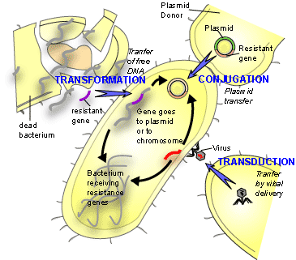
Formation via lateral gene transfer
• mostly occurs between unicellular organisms
(e.g. antibiotic resistance in bacteria)
• not strictly new genes though

Slide 52
• or between phage and bacteria (e.g. virulence factors)
Bacterium | Phage | Gene Product | Phenotype
Vibrio cholerae | CTX phage | cholerae toxin | cholera
Escherichia coli | lambda phage | shigalike toxin | hemorrhagic diarrhea
Clostridium botulinum | clostridial phages | botulinum toxin | botulism (food poisoning)
Corynebacterium diphtheriae | corynephage beta | diphtheria toxin | diphtheria
Streptococcus pyogenes | T12 | erythrogenic toxins | scarlet fever

Slide 53
• Vibrio cholerae did not always cause disease.
• Infection with the CTX phage gives the bacterium its toxinogenicity. (cholerae toxin)
• The phage recognizes a pilus on the surface of the bacterium and uses it to enter the cell.
• Once inside the cell, the CTX phage integrates into the chromosome and the bacteria then expresses cholera toxin.

Slide 54
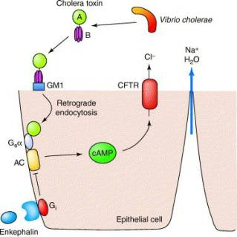
• I mention this one because mutations in some genes including CFTR are skewed between human populations-covered later in the week
• Mechanism of action of Cholera toxin
Notes:
‘When cholera toxin is released from the bacteria in the infected intestine, it binds to the intestinal cells known as enterocytes (epithelial cell in above diagram) through the interaction of the pentameric B subunit of the toxin with the GM1 ganglioside receptor on the intestinal cell, triggering endocytosis of the toxin. Next, the A/B cholera toxin must undergo cleavage of the A1 domain from the A2 domain in order for A1 to become an active enzyme. Once inside the enterocyte, the enzymatic A1 fragment of the toxin A subunit enters the cytosol, where it activates the G protein G_{s}a through an ADP-ribosylation reaction that acts to lock the G protein in its GTP-bound form, thereby continually stimulating adenylate cyclase to produce cAMP. The high cAMP levels activate the cystic fibrosis transmembrane conductance regulator (CFTR), causing a dramatic efflux of ions and water from infected enterocytes, leading to watery diarrhoea.’ https://proteinswebteam.github.io/interpro-blog/potm/2005_9/Page2.htm

